Slide 1
Investigations in Learning Analytics
Bridging Gaps in Higher Education through Data Insights

Slide 2
What is Learning Analytics (LA)?
Broadly:
Measuring, collecting, analysis and reporting of data to garner insights into interactions between learners and the systems they participate in.
What data? In our Institute:
Assessment data (granular and aggregated)
Measures of engagement (attendance, assignment completion status, contributions to discussions, on-campus study space visits, use of university digital network and engagements with SLD)
Measures of self-assessment (reflective tools for LA i.e. focus group data)
Notes:
Learning analytics (LA) is broadly defined as the measurement, collection, analysis, and reporting of data about learners and learning environments - with the main purpose consisting of gaining an insight into the interactions between learners and the systems they participate in (Papamitsiou and Economides 2014). LA encompasses a plethora of conceptual variations with its multi-disciplinary approach that ties together areas of education, psychology, computing and data science (Ifenthaler and Yau 2020).
Within the institute that this study takes place, University of Glasgow, data that has been already utilized for learning analytics consists of assessment data (granular and aggregated), measures of engagement (including attendance, assignment completion, student contributions to discussion, virtual learning environment usage, Moodle statistics, online discussion contributions, measures of visits to on-campus study spaces, use of university digital network, engagement with student learning development), measures of self-assessment through reflective tools and data specially collected for learning analytics, such as focus group data 1 .

Slide 3
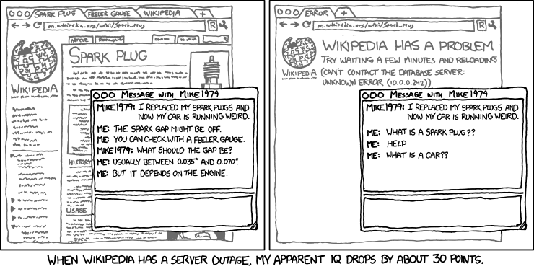
Our motivation surrounding the use of LA.
Transition to higher education often a process spanning several years, with a lot of conceptual schema assimilation > students lack essential self-regulation skills which can be scaffolded with LA
Aligns with pedagogical framework of student-centered constructivism
Examining LA through a connectivist approach, leads to Interesting thought experiments regarding learning and applicable use cases of LA for the student body.
Notes:
The transition from general education to higher involves a lot of conceptual schema assimilation. Students are expected to have an independent style of learning and take responsibility - particularly when it comes to their self-regulation skills. Most of the student body will also have commitments outside of their education, and cannot devout as much if their mental resources and time to the study of their own study - meta education - as is required. Effective use of LA can bridge this gap by dissecting the learning path for students and letting them understand their own development; with regards to prior levels attained, their place in their cohort, the skill sets they leveraged and the concepts they assimilated successfully/unsuccessfully. Gaps in knowledge can be effectively picked up on. Motivational factors further reinforced. Appropriately designed and maintained LA systems have the potential to completely change how students navigate their own educational path.
The current trending pedagogical framework utilized in higher educational institutes in the west is student-centered constructivism - this is centered around active learning, which develops students autonomy and leads to extended control over their own constructions of mental schemata (O’Connor 2022). There are drawbacks to this approach; underlying knowledge in curriculum is viewed as easily transferable across alternate modes of teaching, and disciplinary differences are neglected to the back burner as a trade-off. Differences across schemata due to underlying mis-applications of prior knowledge are particularly difficult to pin-point. In this study we will explore the transferal of knowledge from institute to learner through the lens of connectivism, which incorporates the key elements of constructivist theory along with the principles of networked learning - where learning occurs as a by-product of making connections and navigating information networks.
This allows learning to take on more of a critical role than simply knowing, requiring shifting the educational focus onto aiding learners perceive connections between ideas and concepts.
This is aptly suited to LA as machine learning makes leaps and strides in the field of mapping out knowledge bases. Particular emphasis has been placed on analyzing how students form and change their own narratives during discussions surrounding the use of LA.

Slide 4
Research Aims
Three research questions to focus on;
What insights can we garner from past research and current research with students for an institute-wide LA implementation?
How can institutes best navigate the complex ethical and legal playing field surrounding analytics?
What are the major theoretical factors involved in a successful developmental period and implementation of a LA system?
Notes:
Within the greater bank of prior research done on LA implementations that are institute-wide, the underlying motivations of the institute shape the culture surrounding the implementation. The use of the moniker LA is widely regarded as a buzzword, bringing a black box effect where the lack of clarity is not expanded upon - leaving the actual end goals of the system unclear. Success is often defined numerically within the field - improvements in engagement reflected as an increase in page views, improvements in understanding of the material as higher cohort grade results. Whilst this is satisfactory for a cause-and-effect outcome, the nature of learning is often far more illusive. Within the bank of prior research done in the field, there appears to be limited thought given to the ever-evolving nature of pedagogical frameworks, and how educational narrative shape the interactions of students and staff with implemented LA projects.

Slide 5
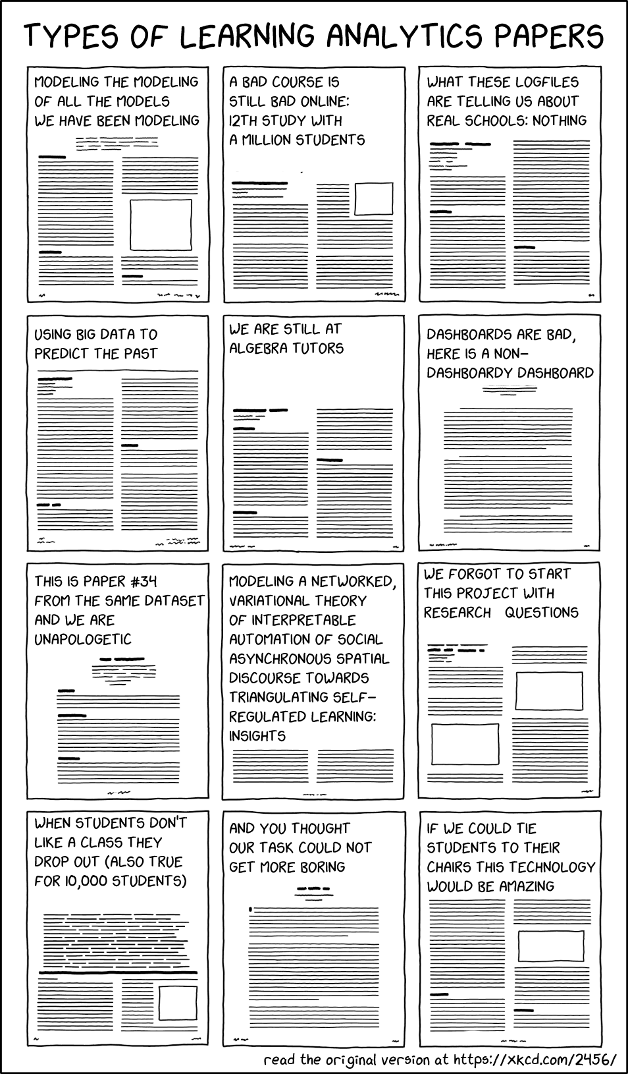
Challenges in the field of LA
Lack of underlying pedagogical framework
Lack of rigorous large-scale evidence for effectiveness of LA implementations
Hot topic regarding the replication crisis
Highly contextual nature of the data
Sensitive nature of data often leads to restrictive and selectively funded research
Or, pseudo-anonymised data that is difficult to interpret holistically
Notes:
The majority of papers written on LA lack an underlying theoretical framework, resulting in an inherent lack of ability to connect findings with meaningful pedagogical guidance (Baek and Doleck 2023; Banihashem et al. 2019; Büchner and Patterson). The field also suffers from a lack of rigorous, large-scale evidence for the effectiveness of LA implementations in learning environments (Ifenthaler and Yau 2020). The use of LA to provide evidence of detecting various constructs relevant to learners and education suffers from a lack of replicability, in part due to the large degree of freedom in research for decisions made regarding content analysis as well as the highly contextual nature of the data itself (Kitto et al. 2023). The often sensitive nature of datasets for LA leads to a restrictive model wherein companies and research groups with access to larger, closed datasets tend to excel - thereby narrowing the reproducibility of results within the field (Kitto et al. 2023).

Slide 6
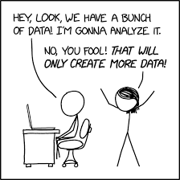
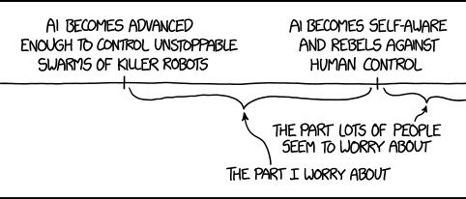
Novel Methodology
Lack of in-depth student-centered LA development in prior research, so we created a novel research methodology!
Use of a prototype as an information-gathering device for insights
Participants initially conduct one on one interviews to garner individual thoughts and idea
Develop the prototype as a team
Changes in insight are tracked,
Notes:
Our first step was conducting a literature review that explores these territory of LA implementations and takes note of particular concerns - a major one being the lack of input present from students during the development process. Learners are hesitant to discuss sensitive information about themselves and their learning process, and are often unclear about the nature of LA implementations, only understanding the benefits of the outcome.
This is why we utilize a novel research methodology that combines best practices around agile product creation with participatory design principles primarily as an information-gathering device to examine perceived insights of a select sub-group of the student population.
The initial interview has been utilized to identify and examine the effects of a subset of theoretical factors on the views that our participants hold of LA with the use of a connectivist lens.
Participants are more than welcome to consider outside sources to aid their insight giving during the initial interview as well as the follow up interviews concerning changes to components for the LA prototype i.e. ’falling down a Wikipedia rabbit hole’ and ending up on the Institute’s own site reading the policy is more than encouraged by us.

Slide 7
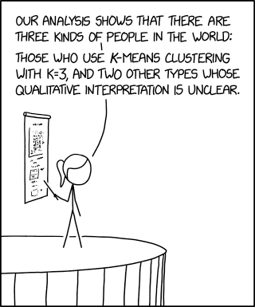
Key Findings
The novel methodology worked well
Learning more about LA does seem to diminish fears surrounding LA!
Students are very concerned around privacy and the commodification of personal data.
Students prefer humans for the most part.
Needs are diverse.
LA is probably inevitable
Notes:
Through our research into the implementation and student perceptions of Learning Analytics (LA) within an educational setting, several key takeaways have emerged. The use of a novel methodology combining agile practices with participatory design principles has facilitated a deep engagement with a select subgroup of students - although it is unclear whether this is primarily due to utilizing our novel methodology or leading research as a student, for students. This engagement has not only revealed insights into students’ expectations and concerns regarding LA but also illuminated shifts in their perceptions of LA as they participated in the development and evaluation of an LA prototype system. Students were less wary of LA after participating in the development process, and prior concerns were, to an extent, perpetuated by negative stereotypes in pop culture.
A critical result from our research indicates a heightened sensitivity among students to the ethical dimensions of LA, particularly around data privacy, autonomy, and the potential for misuse. Students expressed a strong desire for transparency in data handling and a significant degree of control over what data is collected and how it is utilized. This reflects a broader concern about surveillance and the commodification of personal data within digital platforms. Creating a positive culture around the use of LA and encouraging student creativity, digital autonomy and institute transparency dissuaded some concerns. We also place a very strong emphasis on ensuring LA does not replace nor negatively impact the required human connection for students to develop and mature.
Lastly, the research highlights the importance of tailoring LA systems to accommodate diverse student needs and preferences. Participants valued the ability to opt out of certain features, indicating a need for customizable and flexible LA solutions that respect individual boundaries and learning preferences.

Slide 8
Conclusion
Identified theoretical factors
Trust in code and the institute, artificial motivation, unique aspects involved in education, questions around fairness, behaviourism, surveillance capitalism, profiling, data autonomy, self-evaluation, and the importance of maintaining human connections despite changes in relationship.
Through the iterative design and evaluation of the prototype, students’ perceptions of LA as well as the discussion around the identified theoretical factors shifted positively, demonstrating the potential of participatory design in addressing ethical concerns and enhancing the acceptability of LA systems.
Developing a positive institute culture surrounding LA, particularly if it will be an inevitable aspect of higher education, is critical.
Notes:
Identified theoretical factors impacting students perception of LA gathered during initial interviews conducted prior to the design period include; pre-existing trust in code and the institute, concerns raised around artificial motivation, the potential of loosing unique aspects involved in education, questions around fairness, when behaviourism toes the line, the perils of surveillance capitalism, issues surrounding profiling, the need for data autonomy, underlying goal of aiding self-evaluation, and the importance of maintaining human connections despite the changes in relationship that occur (Figure 3.1).
Through the iterative design and evaluation of the prototype, students’ perceptions of LA as well as the discussion around the identified theoretical factors shifted positively, demonstrating the potential of participatory design in addressing ethical concerns and enhancing the acceptability of LA systems.
Our participant group viewed LA as an inevitable change within higher education, and took the mindset of making the change as accommodating as possible to users who could potentially be disadvantaged - rather than simply finding concerns in LA, steps were taken to attempt mitigating the impact of consequences. In the author’s opinion, this mindset would do well to fuel future research within the field.

Slide 9
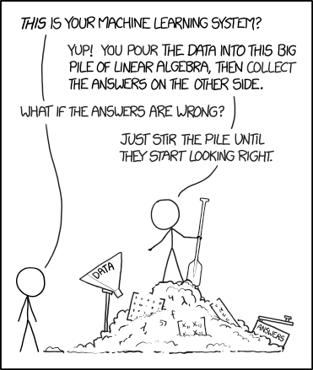
Limitations and Future Work
Limitations:
It is just me encoding 7.2 hours of transcripts - potential for bias.
Selective participation group consisting of people that can withstand the chaos of participatory design conducted by me.
Future work:
Implementing the underlying theoretical machine learning models using a connectivist lens to map out individual knowledge bases that students may have.
Expanding on the novel methodology to include a diverse range of students.
Longitudinal study assessing long term impact of an implemented institute-wide LA
Exploration on evaluating success of an institute-wide LA system that does not reinforce the negative ramifications of Goodhart’s Law
Notes:
The encoding of the transcripts is done through the lens of only one person. This has decreased the validity of the thematic analysis. On a similar note, there most certainly is interviewer and response bias present - particularly due to the pre-existing relationship between participants and the interviewer. Galdas (2017) argues that interviewers carrying out qualitative research are an integral part of the process as well as the final product, and thus separating the researcher from their research is neither possible nor desirable. They subscribe to the notion that any prominence placed on bias comes from the expected requirement for research to have a demonstrable wider impact. Whilst this can be a desirable trait for publication, it raises the question of whether or not viewing bias is a problem that needs to be resolved through positivist lens
Exploring the integration of AI and machine learning technologies by examining the adaptability and predictive capabilities of LA systems represents a promising direction for future work, particularly as there is no implementation of the theoretical backed and machine learning elements discussed through this dissertation. The author acknowledges that creative liberties have been taken with the capabilities of current LA machine learning applications during interview discussions. What exactly these models predict, or the connections and feature maps they make, would be a very intriguing area to conduct research in. This research should be approached with caution, keeping ethical considerations at the forefront to ensure that the deployment of advanced technologies does not compromise student privacy or autonomy. Future research building directly off of our work should direct their focus on expanding the participatory design approach in the novel methodology to include a broader and more diverse range of students. This will help in capturing a wider array of perspectives and needs, fueling the development of more inclusive and effective LA systems. There is a real need in the field of LA for longitudinal studies, to assess the long-term impact of implemented institution-wide LA. Exploratory research should also be conducted on ways of evaluating the success of an institute- wide LA system without introducing measures that could inevitably reinforce the ramifications of Goodhart’s Law.

Slide 10
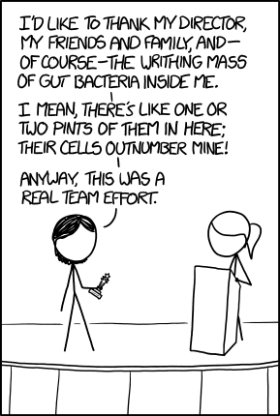
Thank You
Thank you for your attention throughout this presentation! All of this work would not have been possible without my supervisor, Alistair Morrison, and his dedication to talking me into staying on scope. I appreciate it!!!
Mx Elisabet Tammjarv Assistant Demonstrator (School of Computing Science) Senior Residence Life Assistant (Student & Academic Services)
Elisabet.Tammjarv@glasgow.ac.uk 2554321t@student.gla.ac.uk
Image Reference: Munroe, R. (2007) Xkcd. https://xkcd.com/

